Slide 1

Getting Started with WinUI & the Windows App SDK
Alvin Ashcraft
Sr. Content Developer
Microsoft
Level: Beginner
Notes:
Welcome to my session on getting started with WinUI and the Windows App SDK. Let’s get started!

Slide 2

Session Survey
Your feedback is very important to us
Please take a moment to complete the session survey found in the mobile app
Use the QR code or search for “Converge360 Events” in your app store
Find this session on the Agenda tab
Click “Session Evaluation”
Thank you!
Notes:
Make sure to complete your session surveys. Your feedback helps the event, and it helps me improve my talks.

Slide 3
About Me
Software industry for nearly 30 years
Morning Dew link blog
Three books for Packt Publishing
Content developer at Microsoft since 2022
TechBash dev conference organizer since 2016
Notes:
A little background about me…
For those who don’t know me, I’ve been in the software industry since 1995, with most of that time (over 25) years spent as a developer and architect using various Microsoft technologies.
Some of you may also be familiar with my blog, the Morning Dew, where I’ve been posting daily links for .NET developers since 2007.
I also have three books from Packt Publishing. You can check those out on Packt’s website or on Amazon. Just search for my name.
Writing those books led me to pivot my career to technical writing. I joined Microsoft two years ago as a content developer. I write documentation, training modules, and code samples on Microsoft Learn. I work on the Windows developer docs team, helping to maintain the docs for client apps and APIs. I have another talk I give about my work as a content developer and how anyone can contribute to content on Learn through GitHub issues and PRs.
Finally, I’m one of the founding organizers of the TechBash developer conference. We’ve been running the event in the Poconos since 2016.

Slide 4
Agenda
Overview of WinUI 3 & Windows App SDK
Creating a new WinUI 3 project
Working with controls & styles
Model-View-ViewModel with the MVVM Toolkit
Leveraging Windows Community Toolkit controls
Windows App SDK notifications API
Interop options – XAML Islands and WebView 2
Discussing deployment options
Cross-platform app demo w/ Uno Platform
WinUI 3 roadmap
Notes:
Here’s a look at what we’ll be covering in the session today.
We’ll start with an overview of WinUI and the Windows App SDK and talk about how they’re connected.
Next, we’ll jump right into Visual Studio to create a new WinUI project. We’ll see what you get out of the box, and how a couple of quick tweaks can improve the appearance of any app.
Then we’ll look at some of the controls that are included in WinUI and see how you can apply styles that match your users’ Windows theme choices.
In that same project, we’ll see how easy it is to implement the MVVM pattern with the MVVM Toolkit that’s part of the .NET Community Toolkit from Microsoft.
Next, we’ll look at another project which uses some controls from the Windows Community Toolkit, and we’ll also explore the Windows Community Toolkit Gallery app.
We’ll see an app that implements App Notifications. These are APIs from the Windows App SDK that allow your app to send or receive notifications using Windows toast notifications.
We’ll talk about the interop options you have with WinUI and look at some of the deployment options.
Finally, we’ll wrap up by taking a quick look (depending on time) at an Uno Platform project and talk about what’s on the WinUI roadmap and where you can find it.

Slide 5
Overview of WinUI
WinUI 3 is part of the Windows App SDK
Windows App SDK 1.0 released in March 2021
Decoupled from Windows SDK dependencies
Built on latest .NET runtime - build apps on .NET 9
Create apps in XAML & C# or C++
Latest release - Windows App SDK 1.7
Source on GitHub: github.com/microsoft/microsoft-ui-xaml
Notes:
A brief history and some background on WinUI 3 and the Windows App SDK.
WinUI 3 is a part of the Windows App SDK. It’s probably the main thing that most people associate with Windows App SDK, but the SDK has APIs and capabilities that can be leveraged from WinUI 3 apps and other Windows apps.
WinUI 3 was released in March of 2021 along with version 1.0 of Windows App SDK. It came out about a week after the first edition of my WinUI book was published.
WinUI C# apps run on the .NET runtime. You can create WinUI 3 apps on .NET 8 and 9 today, but I’m getting ready to start trying it with the .NET 10 preview.
.NET developers will create a C# app with a XAML UI, but you can also use C++ and XAML. You could also technically create the contents of your UI in your C# code-behind files, but you still need to have a XAML file to host the root page or Window element.
The latest release of Windows App SDK is version 1.7, which is out in preview and should be released next week. They’re just going through some final regression testing on the latest builds.
If you attended my session yesterday, we compared WinUI to some of the other Windows development frameworks. We also have a Windows Developer FAQ on Microsoft Learn that discusses the options available to developers.
WinUI is released as read-only on open source. That means that while you can’t contribute PRs, you can use the source for some enhanced debugging. There was a WinUI Community Call last year where the team demonstrated how debugging with the source can help pinpoint problems while debugging. Those calls are all up on the Windows Developer YouTube channel.

Slide 6
Demo – Hello WinUI
- Create a new WinUI project in Visual Studio
- Working with controls & styles
- Model-View-ViewModel with the MVVM Toolkit
Notes:
We’ll do a couple of quick demos next. One will be starting a new WinUI project in Visual Studio. The second project is taken from Chapter 5 of my book. We’ll examine some of the controls and see how I used the MVVM Toolkit from the .NET Community Toolkit to leverage the MVVM pattern in my code.
Create new WinUI 3 in Desktop project. Add Mica look and new TitleBar after updating to latest .NET and WinAppSDK.
Open ControlsAndMvvm folder to explore controls and MVVM concepts.

Slide 7
Leverage the Windows Community Toolkit
WinUI 2 (UWP), WinUI 3 & Uno Platform
Animations, triggers, behaviors, controls & helpers
Open source on GitHub: https://github.com/CommunityToolkit/Windows
Docs on Learn: https://learn.microsoft.com/dotnet/communitytoolkit/windows/
WCT Gallery app on the Microsoft Store: https://www.microsoft.com/store/apps/9nblggh4tlcq
Demo – View the gallery & use toolkit controls in your app
Notes:
The Windows Community Toolkit, like the .NET Community Toolkit is an open-source project with controls, helpers, animations, behaviors, and lots more.
The source and documentation are both stored in GitHub, and the documentation is surfaced on Microsoft Learn under the .NET docs.
Explore the Windows Community Toolkit Gallery app.
Chapter 9 code has Community Toolkit controls in the CommunityToolkit folder.

Slide 8
Notifications Demo
Using the Windows App SDK Notifications APIs
Notes:
The next demo is taken from Chapter 8 in my book. We’ll see how Windows App SDK app notifications are implemented in a WinUI 3 app.
- Open demo project from Notifications folder.

Slide 9
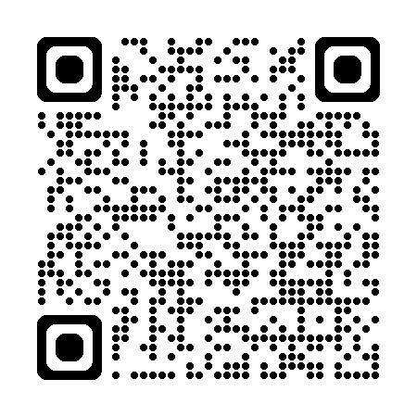
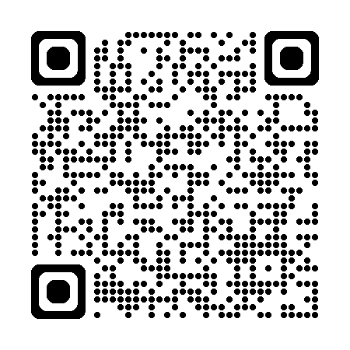
Interop
XAML Islands (ContentIsland)
Added in Windows App SDK 1.4
Currently only available with C++ Win32 apps
Sample on GitHub
No wrapper for WinForms / WPF use yet
WebView2 Control
Blazor
PWA
MapControl is a custom WebView2
Get started docs on Microsoft Learn
Notes:
There are a few options for different types of interop in a WinUI app.
There isn’t a full-featured interop host yet for WinUI like you have for hosting WPF controls in a WinForms app or vice-versa. There is a ContentIsland and related classes in the Microsoft.UI.Content namespace. They were released in Windows App SDK 1.4, but they’re currently only available in C++ Win32 apps. There’s no wrapper to use Islands in WinForms or WPF yet. You can check out the sample on GitHub for more information.
Another option is to embed some web content in your WinUI app with a WebView2 control. In chapter 12 of my book, I created and deployed a Blazor app and host in a WinUI client app. There are also some folks who have gotten the .NET MAUI Blazor Hybrid webview control to work in a WinUI app. Using that, you can run a Blazor app embedded in your project rather than loading it from the cloud. This way, you could potentially share local resources and run some functionality offline.
Let’s look at that WebView2 with Blazor demo from Chapter 12 of my book.
If there’s time, we’ll also look at a simple C++ Islands sample taken from Microsoft’s Windows App SDK samples repo.

Slide 10
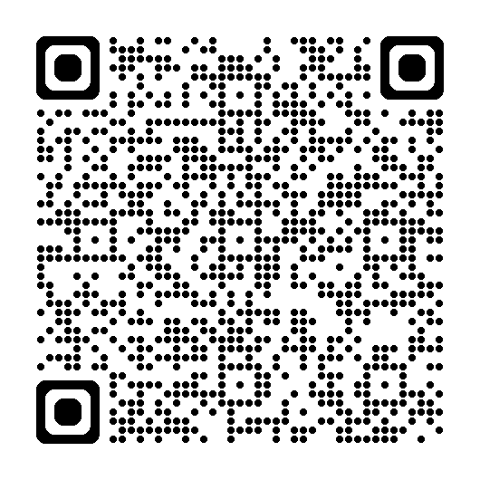
Deployment Options
Packaging Options
Framework-dependent packaged apps (default)
Framework-dependent unpackaged apps
Self-contained apps
Microsoft Store
Windows Package Manager (WinGet)
Sideload an MSIX
Instructions for packaging a .NET MAUI app work with WinUI projects w/ Windows App Packaging project
Sideload works to deploy MSIX with Enterprise deployment tools too
Third-party installers
Advanced Installer
InstallShield
Notes:
Deployment options.
WinUI has several packaging options.
First off, your apps can be either “framework-dependent” or “self-contained”. Framework dependent apps rely on the Windows App SDK runtime being present on client machines. Self-contained apps deploy the runtime with your app. Each method has pros and cons.
Self contained – Larger installer but you control the runtime version. But that also means you need to deploy updates to your app to provide any runtime bug-fixes.
Framework dependent (the default) – Smaller installer but you’re relying on users to keep updated with SDK updates and fixes.
For getting your app to your users, you can package and submit it to the Microsoft Store, you can use WinGet (the Windows Package Manager), you can sideload your app (deploy it without the Store or WinGet – this isn’t officially documented for WinUI, but the documented .NET MAUI method for Windows does work with WinUI apps too). You can also use third-party installer solutions. Advanced Installer and InstallShield are a couple of the well-known options.
We’re not going to do a live demo of this, but the online documentation and the deployment chapter in my book get into plenty of detail.

Slide 11
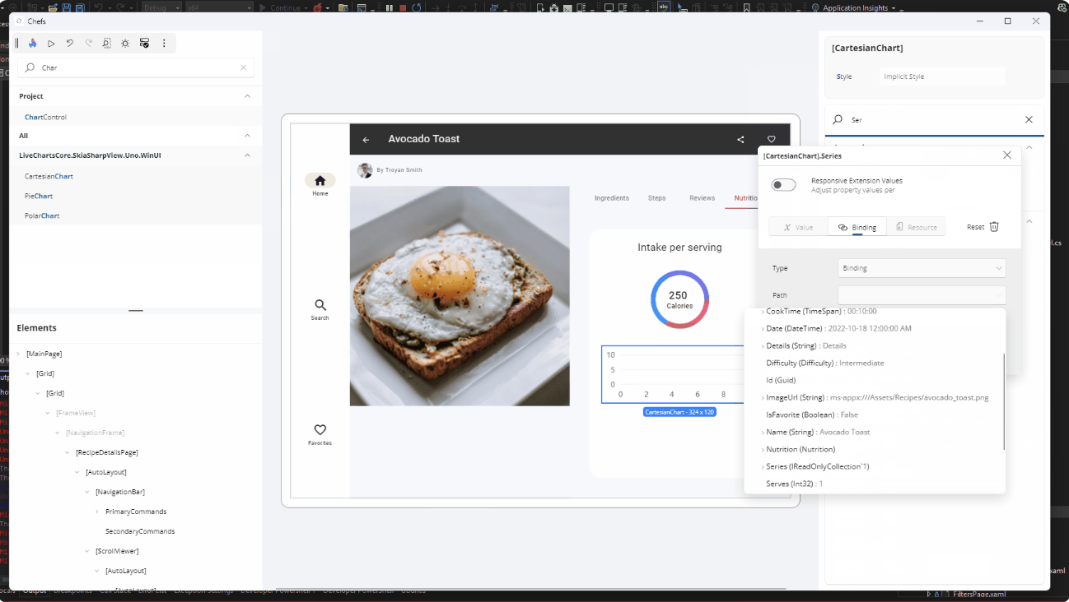
Uno Platform with Hot Design
Take your WinUI code to iOS, Android, macOS, Linux, and the web
Hot Design (Preview)
Use your running app as a design surface
Notes:
Uno Platform is an open-source.NET platform that allows you to build single codebase native mobile, web, desktop, and embedded apps. It acts as a bridge for WinUI apps to run natively on iOS, macOS, Android, Linux, and WebAssembly.
This allows you to write your C# and (optionally) XAML source code and compile it on different platforms while having it behave the same at runtime.
Uno recently released a public beta of their Hot Design UI designer that runs independently of your IDE. That means you can use it whether you’re developing in Visual Studio, VS Code, or JetBrains Rider, all of which are supported by Uno.

Slide 12
Cross-Platform Demo
Take your WinUI app cross-platform with Uno Platform
Notes:
Now let’s take a quick look at an Uno Platform version of the My Media Collection app that we looked at in some previous demos. We’ll try running this in Windows and in the browser with WebAssembly.
Chapter 13 has Uno Platform project, and it’s in the UnoMediaCollection folder in GitHub.
(Run from D:\dev\UnoMediaCollection\)

Slide 13
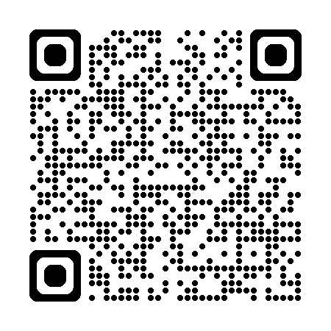
WinUI Roadmap
Up next: Windows App SDK 1.7 & 1.8
OAuth2Manager, BackgroundTaskManager, CameraCaptureUI, TitleBar improvements in 1.7
Continued work on XAML Designer in 1.7 & 1.8
WinUI & Windows App SDK roadmap
Notes:
You can check out the WinUI and Windows App SDK roadmaps on GitHub, but these are some of the items currently slated for the upcoming versions.

Slide 14

Visual Studio Hub
Your one-stop destination for everything Visual Studio
https://aka.ms/vshub
Notes:
Make sure you stop by the Visual Studio Hub this week to talk to Microsoft experts.

Slide 15
Thank you!
Questions?
Contact me
Email: alvin@alvinashcraft.com
Bluesky: https://bsky.app/profile/alvinashcraft.com
Notes:
And that’s all we’ve got for this month. Thank you! Any questions?

Slide 16
Session Survey
Your feedback is very important to us
Please take a moment to complete the session survey found in the mobile app
Use the QR code or search for “Converge360 Events” in your app store
Find this session on the Agenda tab
Click “Session Evaluation”
Thank you!
Notes:
And don’t forget to complete your session surveys!

